Slide 1


“Key-Agricultural Commodities Daily Market Price Prediction using Deep Neural Network”
Submitted By, Name: Tejas Verghese Roll No.: 0111CS141111 Department of C.S.E. Technocrats Institute of Technology, Bhopal | Guided By, Asst. Prof. Mayank Pathak Department of C.S.E. Technocrats Institute of Technology, Bhopal

Slide 2
CONTENTS
Introduction
Technologies Used
Theory
Sample Dataset
Use Case Diagram
Project Windows
Login Window
Selector Window
Main Window
Additional Dialog Windows
Conclusion
References
FIN

Slide 3
INTRODUCTION
The Project primarily focuses on Daily Market Price Prediction for Key-Agricultural Commodities using Open and Free Datasets that are maintained by the Indian Government.
Key-Agricultural Commodities such as – Paddy, Black Grams, Chickpeas, Dry Peas, etc.
The datasets are used to train the Artificial Neural Network to Predict the future market scene, such as – Maximum Prices, Minimum Prices and Modal Prices of individual commodities.
The Data is predicted in tabular form, with the columns such as -
State
District
Market
Commodity Name
Arrival Date
Minimum Price
Maximum Price
Modal Price

Slide 4
TECHNOLOGIES USED
TensorFlow :
TensorFlow is an open source software library for high performance numerical computations.
Its flexible architecture allows easy deployment of computation across a variety of platforms(CPUs, GPUs, etc.).
Originally developed by researchers and engineers from Google.
Keras :
Keras is a high-level neural networks API, written in Python and capable of running on top of TensorFlow, CNTK, or Theano.
It was developed with a focus on enabling fast experimentation.
Allows fast prototyping of Deep Learning neural network models.
Qt for Python :
Qt is a Tool used for rapid GUI creation in Python.
It was developed as part of the Qt Project.

Slide 5
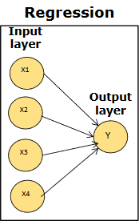
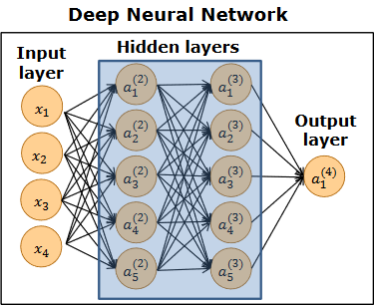
THEORY
Deep Neural Networks (DNN):
A Deep Neural Network is a type of ANN(Artificial neural network).
An ANN has just 1 hidden layer, whereas a DNN has at least 2 hidden layers.
It is like a series of Logit Regressions with intermediate factors representing hidden layers.

Slide 6
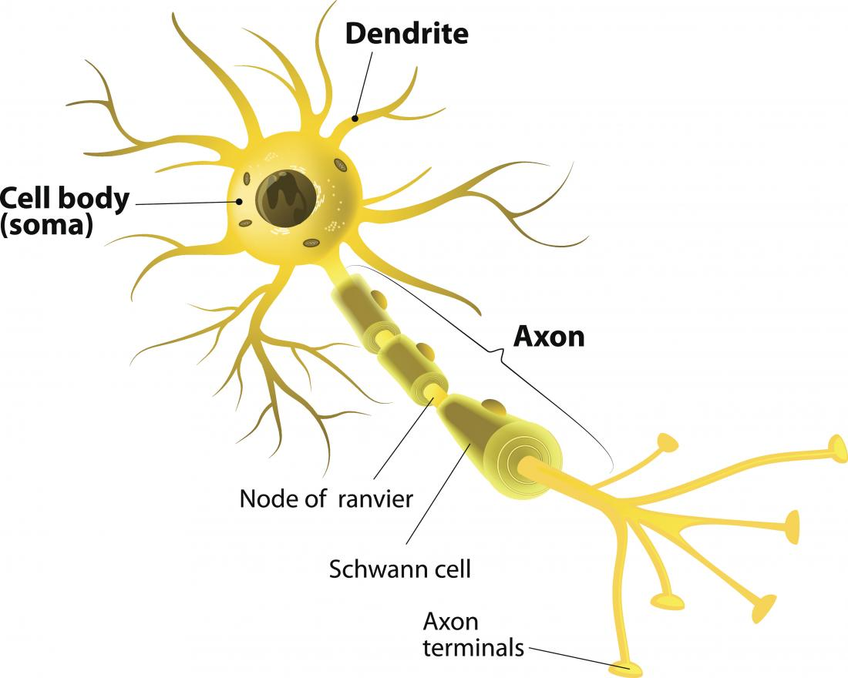
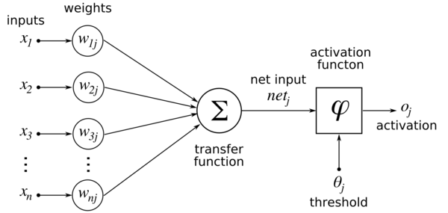
THEORY (cont.)
Terminology:
Neurons:
Cost Function: It is used to measure the level of error in the predicted value.
Epoch: When we process the entire dataset and train our neural network to the dataset values, the model will have completed 1 epoch.
Stochastic Gradient Descent: a.k.a. Incremental Gradient Descent, is a stochastic approximation of the gradient descent optimization and iterative method for minimizing an objective function that is written as a sum of differentiable functions.
Backpropagation: short for, “Backward Propagation of Errors”, is an algorithm for supervised learning of artificial neural networks using gradient descent.

Slide 7
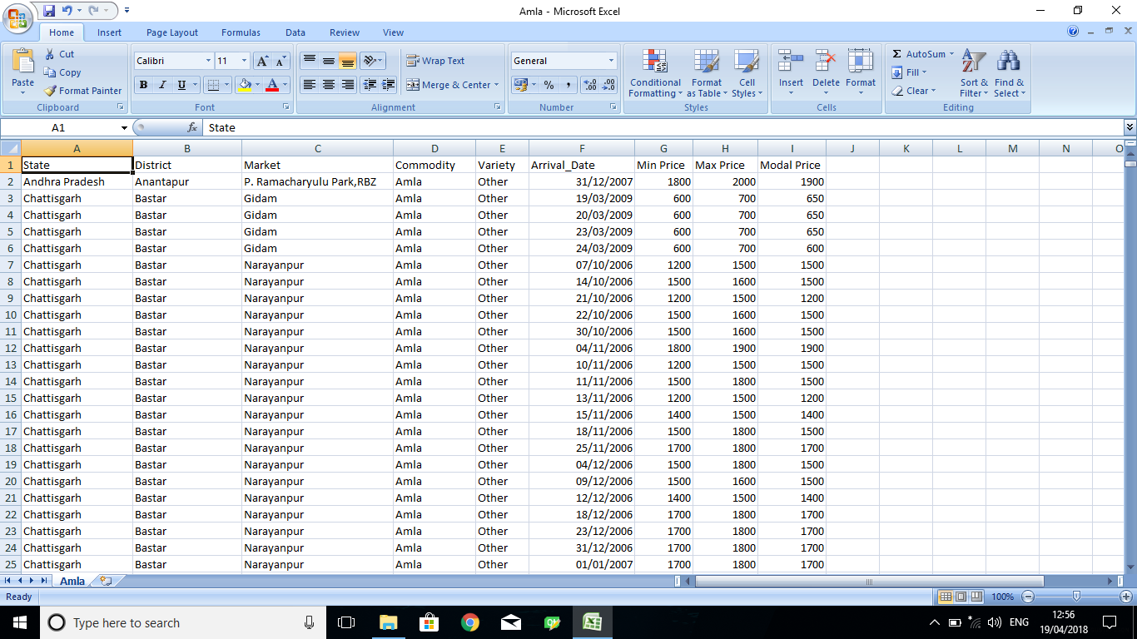
Sample Dataset
Amla:

Slide 8
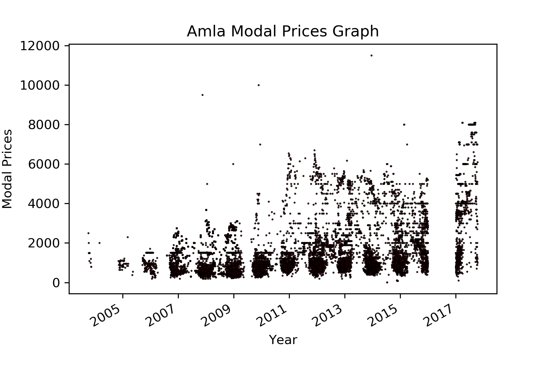
Sample Dataset
Amla(Graph):

Slide 9
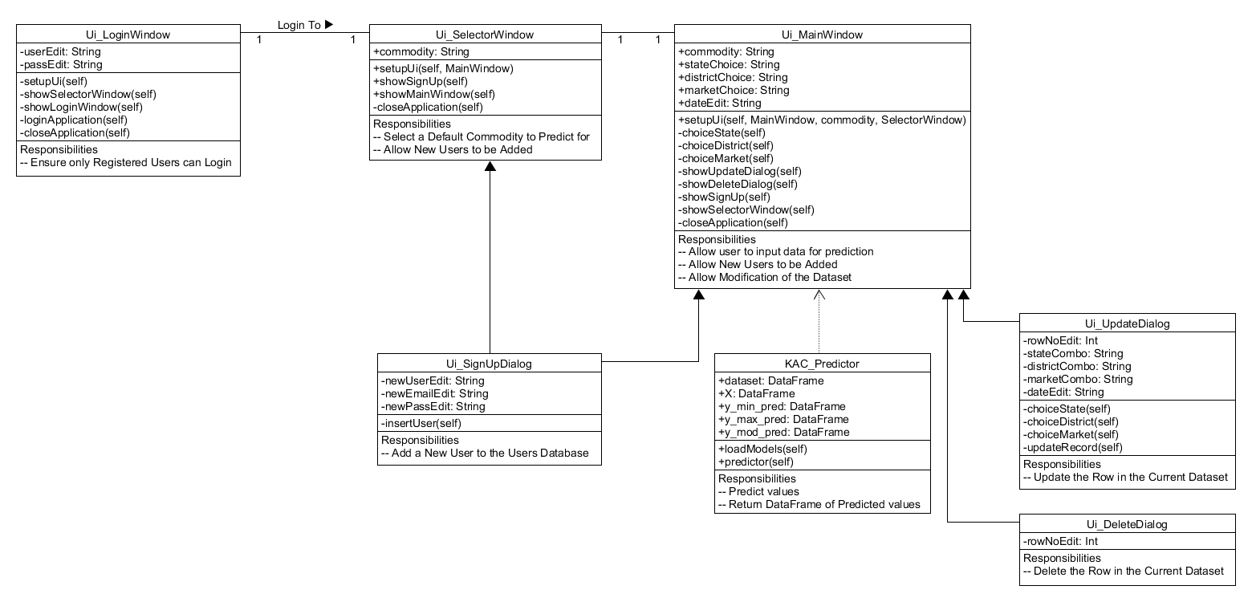
Class Diagram

Slide 10
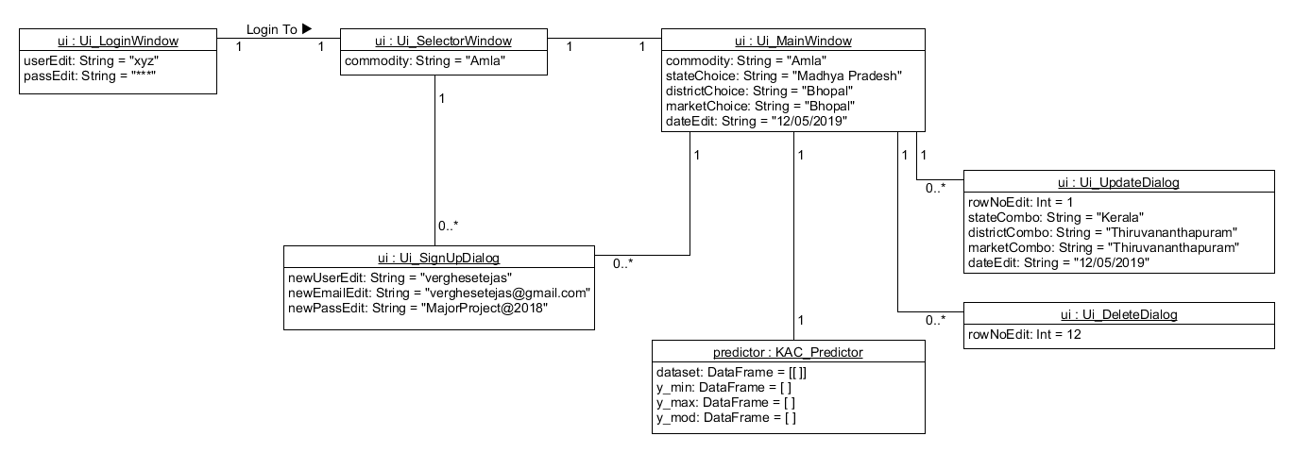
Object Diagram

Slide 11
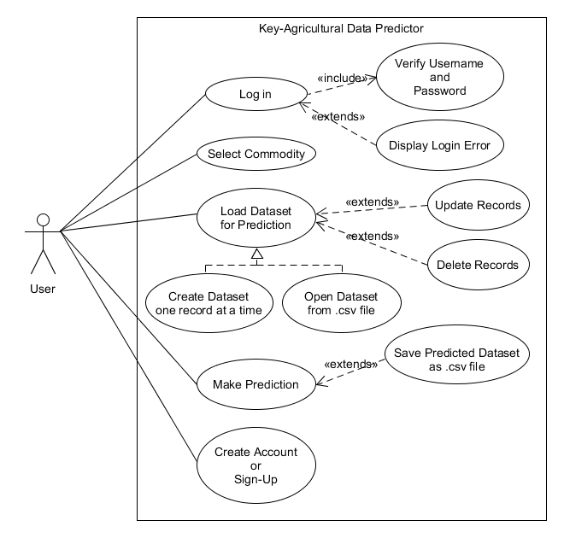
Use Case Diagram

Slide 12
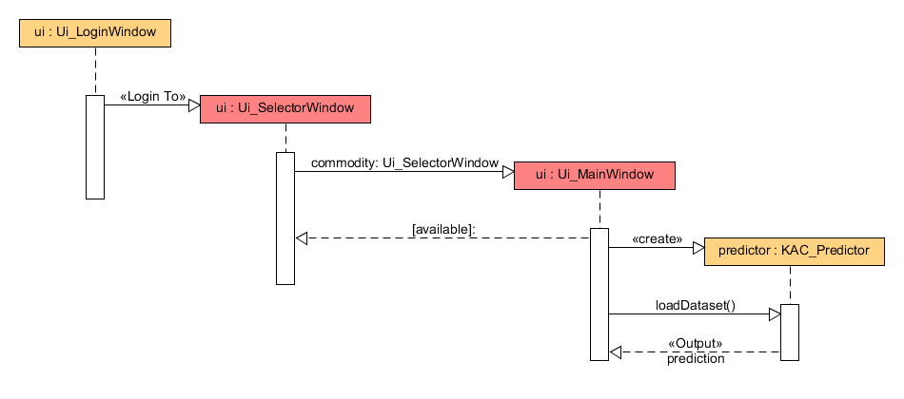
Sequence Diagram

Slide 13
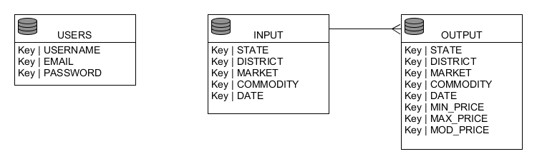
E-R Diagram

Slide 14
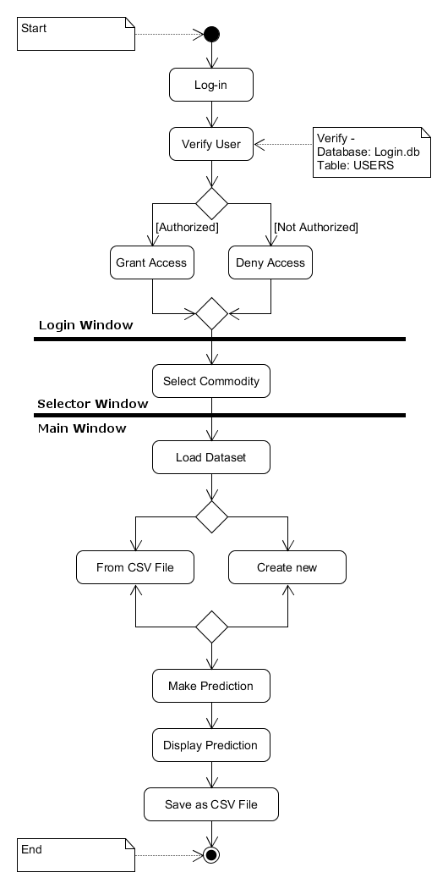
Activity Diagram

Slide 15

Project Windows

Slide 16
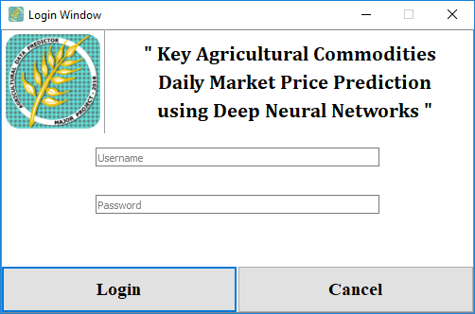
Login Window

Slide 17
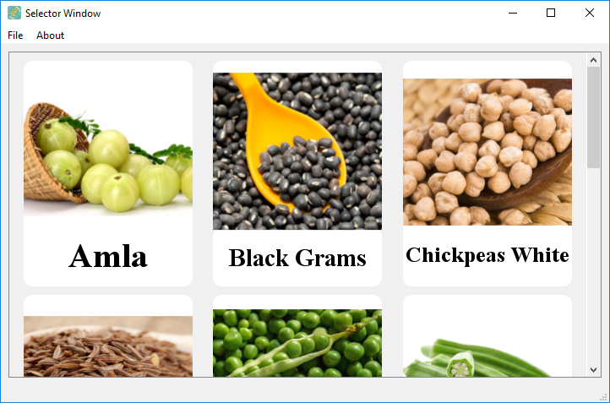
Selector Window

Slide 18
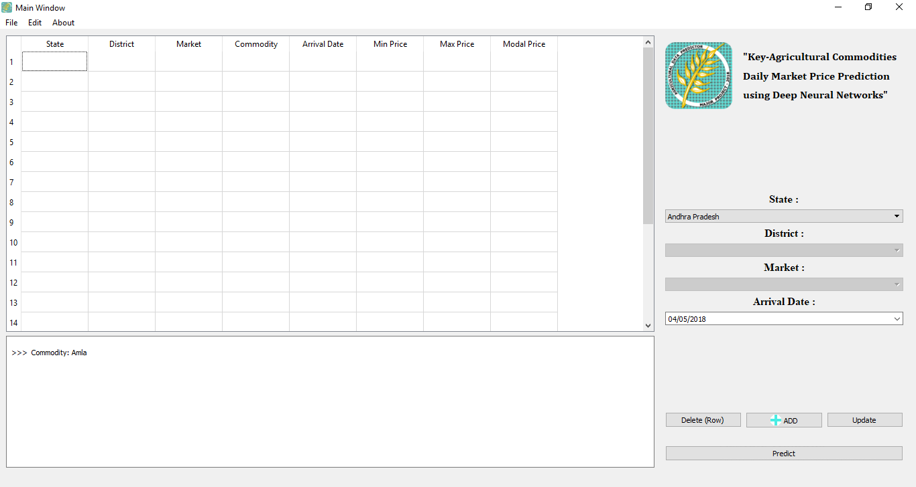
Main Window

Slide 19
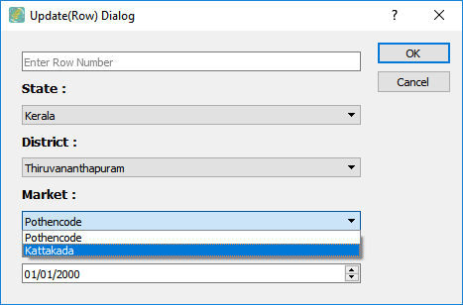
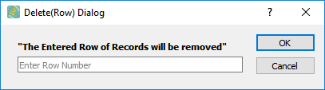
Additional Dialog Windows
Update Dialog Window:
- It is used to update or modify any individual rows in the dataset.
Delete Dialog Window:
- It is used to remove an entire row from the dataset.

Slide 20
CONCLUSION
The Project creates a Deep Learning Model that is capable of understanding Government Agricultural Commodity Data.
Use the State, District, Market, Commodity and Arrival Date columns as Independent variables.
Predict Future Agricultural Market Scenario, i.e., Minimum Prices, Maximum Prices and Modal Prices of Commodities.
And Create appropriate datasets for daily market value prediction.
It can also be used to Create, Read, Update, Delete, etc. records in new Dataset.

Slide 21
REFERENCES
Open Government Data
Datasets acquired from: https://data.gov.in/sector/agriculture
Neural Networks and Deep Learning, Michael Nielsen (2015)
Link: http://neuralnetworksanddeeplearning.com/chap2.html
A Neural Network in 13 lines of Python (Part 2 – Gradient Descent), Andrew Trask (2015)
Link: https://iamtrask.github.io/2015/07/27/python-network-part2/
A list of cost functions used in neural networks, alongside applications, CrossValidated (2015)
Link: http://stats.stackexchange.com/questions/154879/a-list-of-cost-functions-used-in-neural-networks-alongside-applications
Deep sparce rectifier neural networks, Xavier Glorot et al. (2011)
Link: http://jmlr.org/proceedings/papers/v15/glorot11a/glorot11a.pdf
Efficient BackProp, Yann LeCun et al. (1998)
Link: http://yann.lecun.com/exdb/publis/pdf/lecun-98b.pdf

Slide 22
THE END

